Slide 1

StreetSafe
Stay Informed. Stay Safe
Crisis42
Notes:
An app for seeing where it’s safe, avoiding where it’s not, and learning how to stay protected.

Slide 2
Meet the Team
Cory Brown
Osman Teklies
Dominic Simpson
PM
Backend Developer
Backend Developer
Frontend Developer
Rose Childs
Gayathri Krishnan
Technical Lead
Frontend Developer

Slide 3
Agenda
The Problem & Solution
Our App & Its Uses
Planning & Delivery
Testing
Project Reflection
01
02
03
04
05

Slide 4
The Problem &
Solution
01

Slide 5
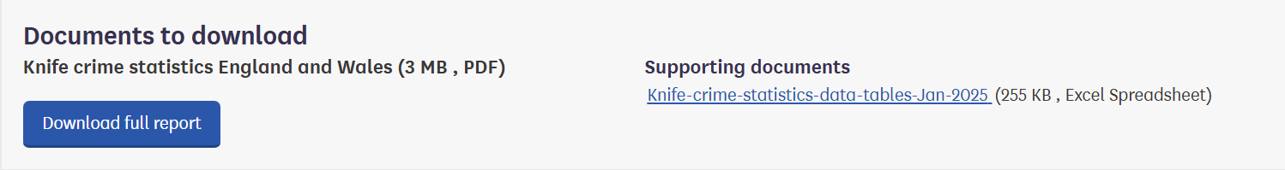
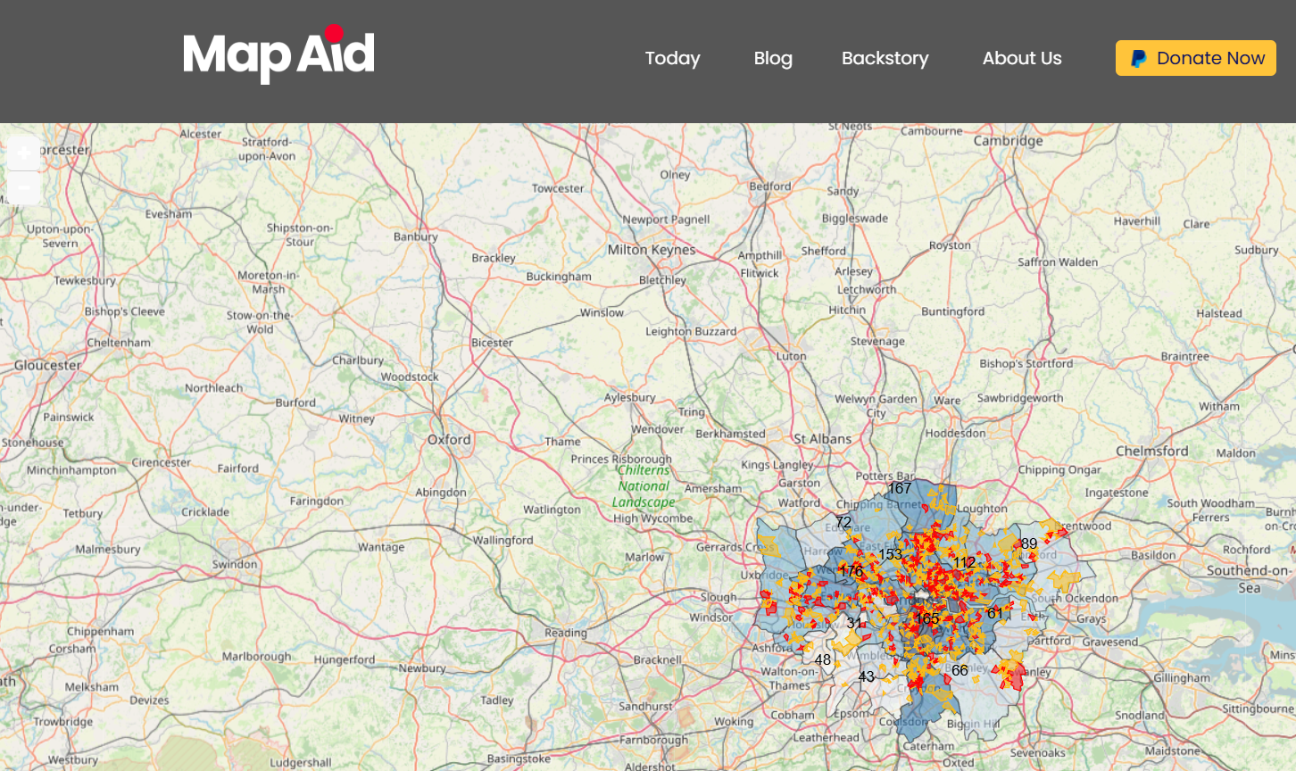
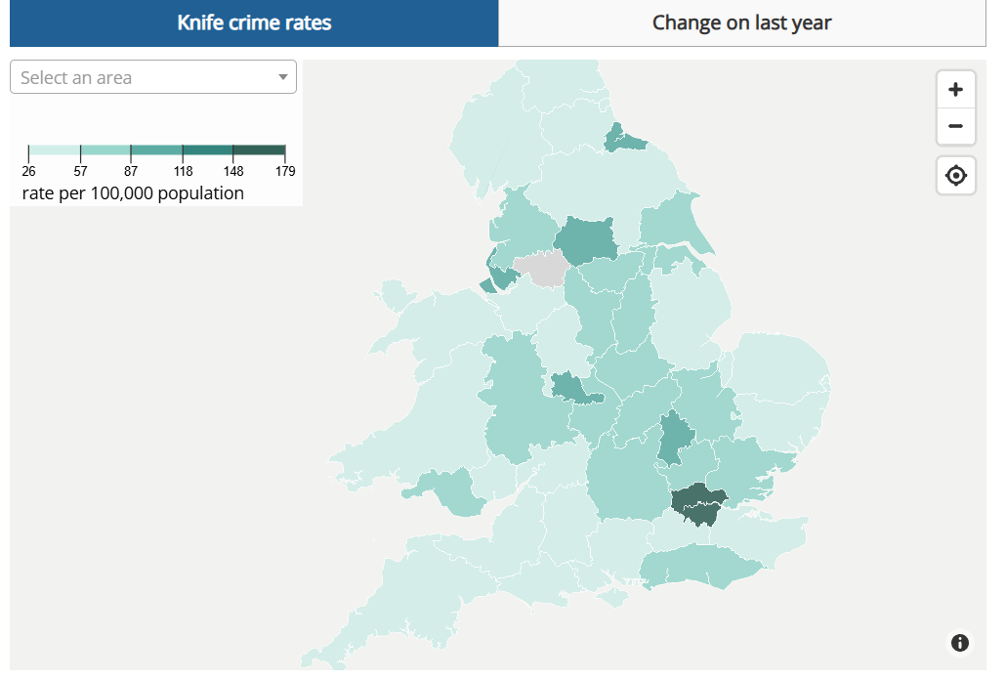
The Problem
Most UK crime data is buried in clunky dashboards and datasets few people use. People need a simple visual tool that maps crime, suggests safer routes, providing resources that turns awareness into prevention
So what's the solution?
Notes:
UK crime data is hidden in complex dashboards and datasets that most people won't use. This leaves little insight into local risks and making everyday decisions - like choosing a safe way home harder than they should be. People need a simple, visual tool that maps crime and provides safer routes, while also offering prevention resources to turn awareness into action.

Slide 6
The Solution
Our app makes crime data simple and useful:
It maps crime incidents in a visually appealing graph
Shows crime trends in clear graphs
Offers tailored prevention resources
Builds the safest route from A to B.
The goal - greater safety, transparency, and education that helps people avoid risk and make smarter choices.
Notes:
do the same for this. Our app makes crime data simple and accessible by Visualising incidents on an interactive map Highlighting crime trends in easy to read graphs Delivering tailored educational resources so users not only avoid risk but also understand how to prevent it Create the safest route from users’ location to destination. By developing this app, we hope to increase transparency about local safety, provide accessible education on the dangers of violent crime and support individuals with resources that encourage prevention and safer choices.

Slide 7

Our App & Its Uses
02

Slide 8
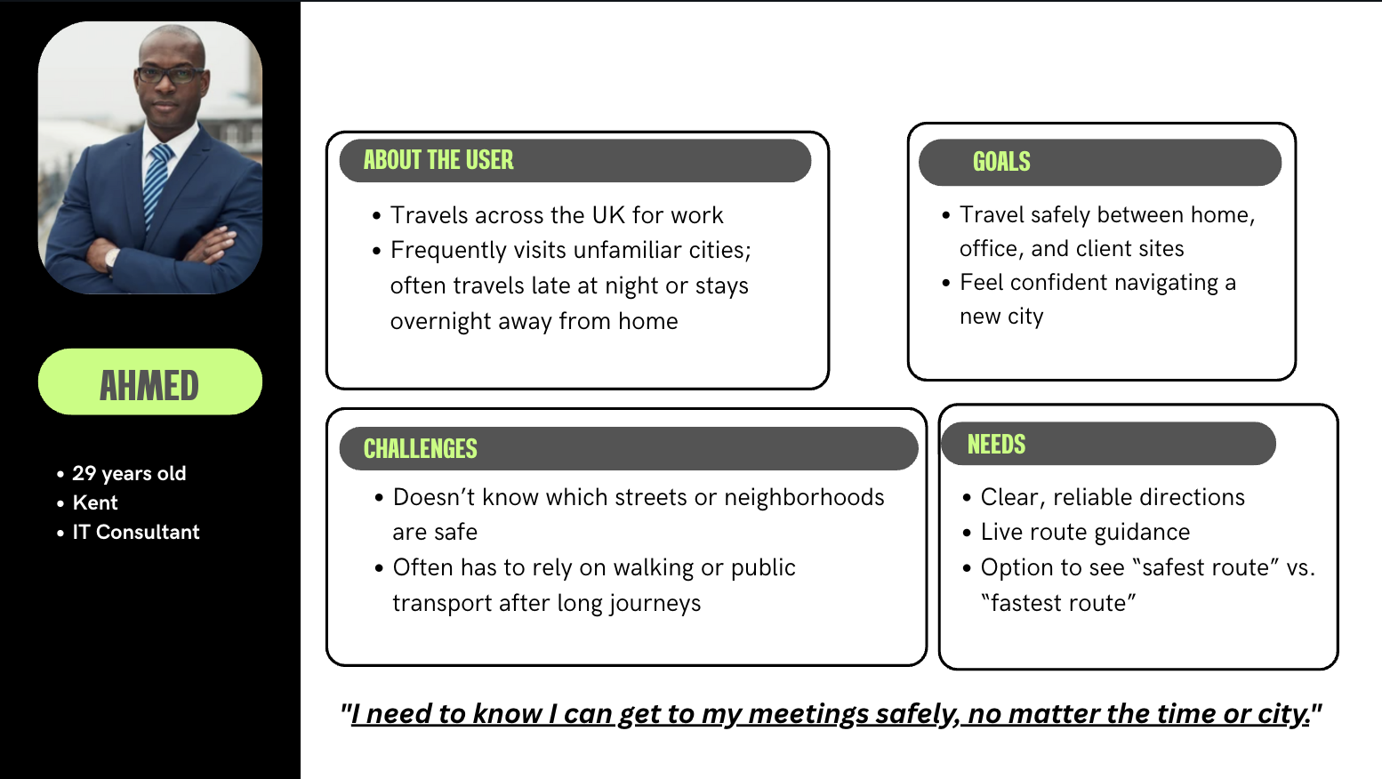
Personas

Slide 9
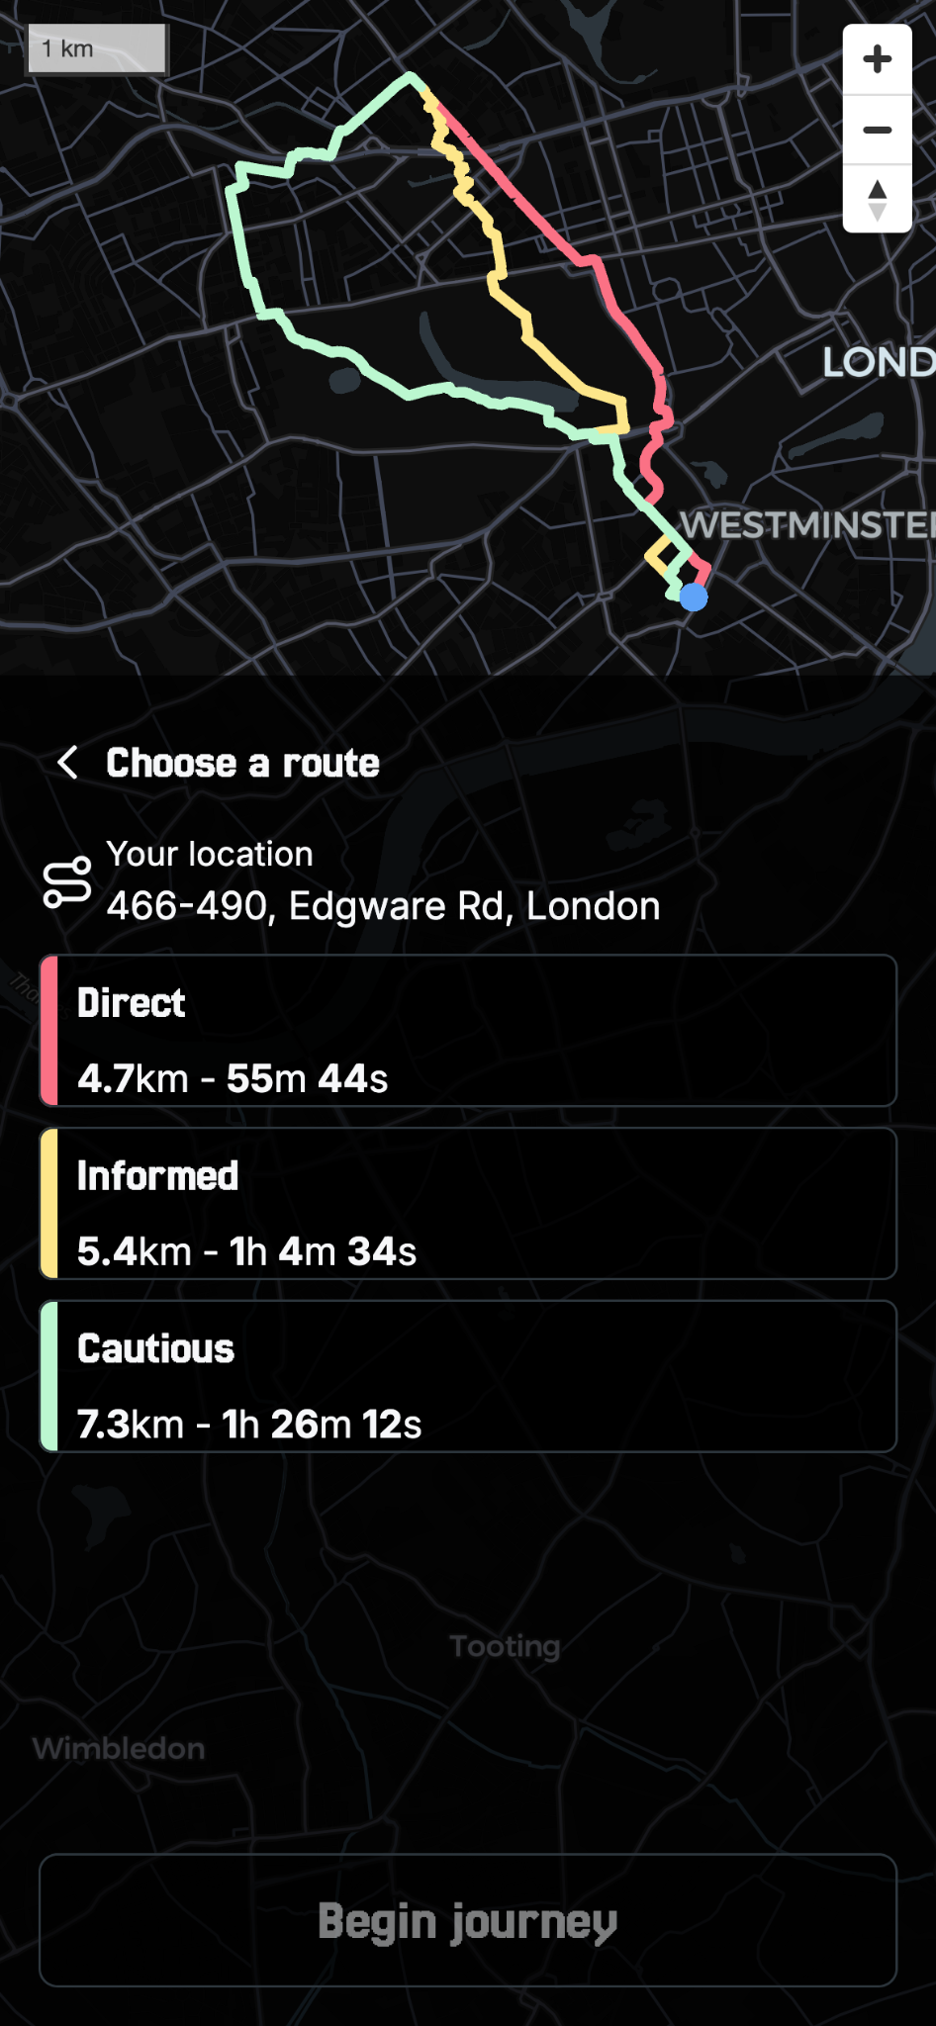
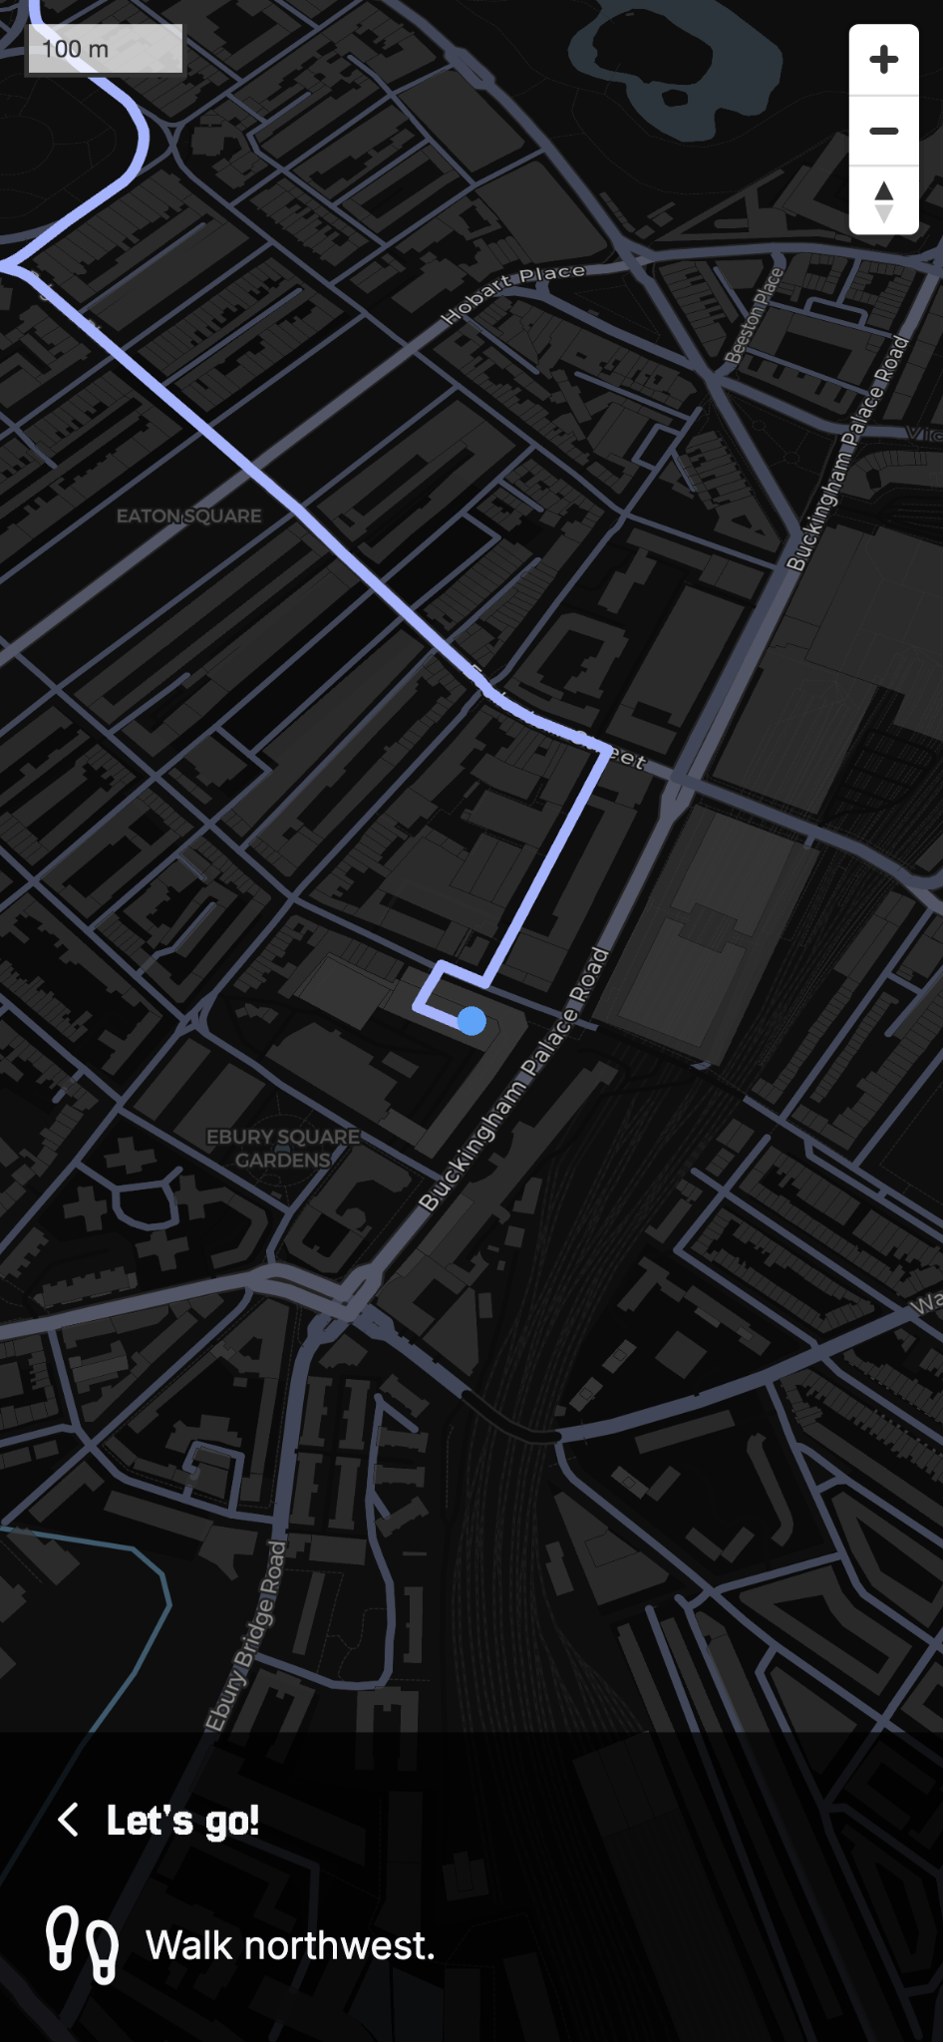
USP
StreetSafe
GO
Notes:
StreetSafe Go is our flagship feature. Using our crime database and high-resolution population data, our custom routing engine built on Valhalla helps you get from point A to point B while avoiding high crime rate areas.
I used StreetSafe Go this morning to get to the office, and I’d like to show you how it works.

Slide 10
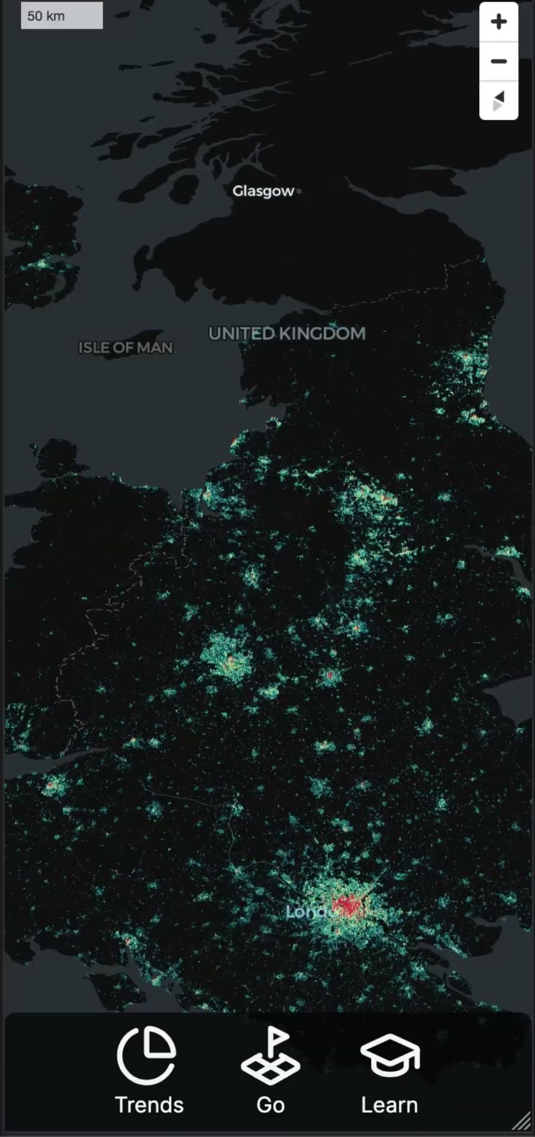
Go Demo
[ see notes ]
Notes:
*Video starts at Victoria Station. Clicks Go, enters LaFosse Academy. Route loads.*
From the main page of StreetSafe, we press the Go button and enter our destination, LaFosse Academy. The routing engine then calculates the best paths based on safety and efficiency.
*Direct, Informed and Cautious routes appear*
Our routing engine has calculated 3 routes, each with different levels of crime avoidance. First, we have “Direct”. This route doesn’t factor in crime data whatsoever, and tends to be the fastest. Then, we have “Informed”. This route favours lower crime rate areas, and will make small deviations to avoid higher crime rate areas. Finally, we have “Cautious”. Cautious will try to avoid high crime rate areas no matter what, and tends to be quite a bit longer than the previous routes. Let’s select “Informed” for this journey.
*Informed is selected, we start the journey*
The app focusses on my location and rotates to match my real-world heading. As I walk, instructions update in real-time at the bottom of the screen.
*Destination is reached, cake icon shown*
Now I’ve reached my destination, I can close the Go page and continue on with my day.

Slide 11
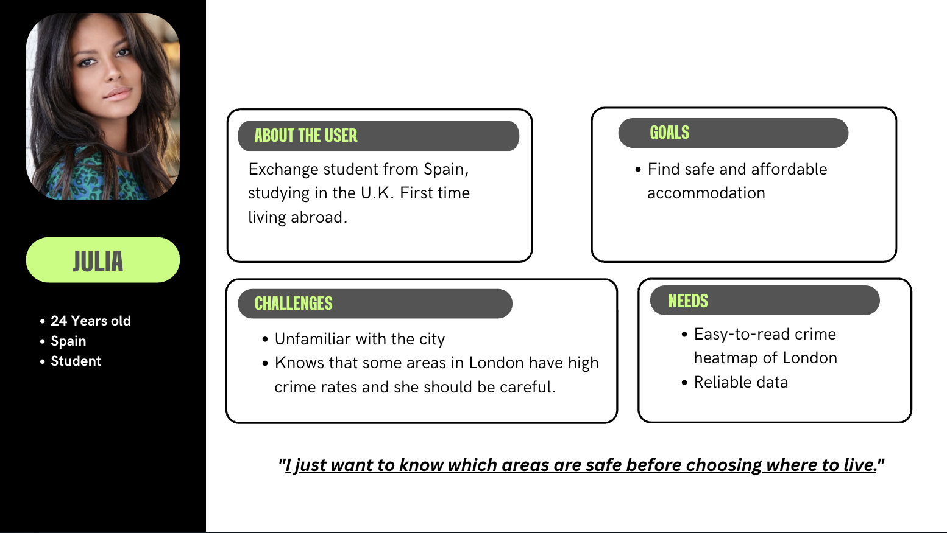

Slide 12
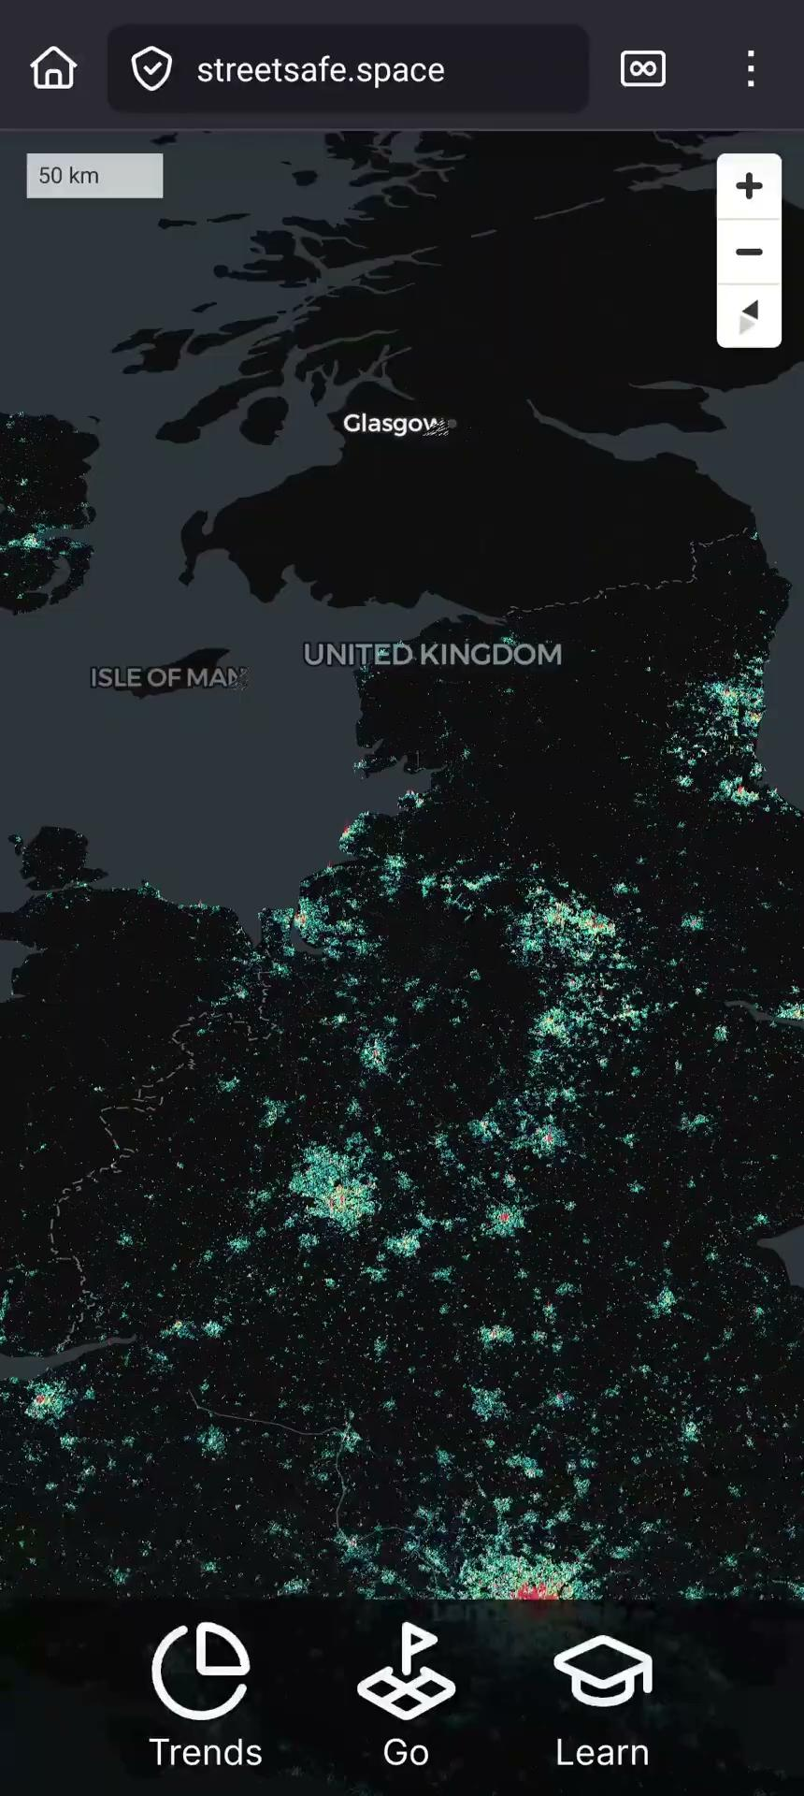
Map Demo

Slide 13
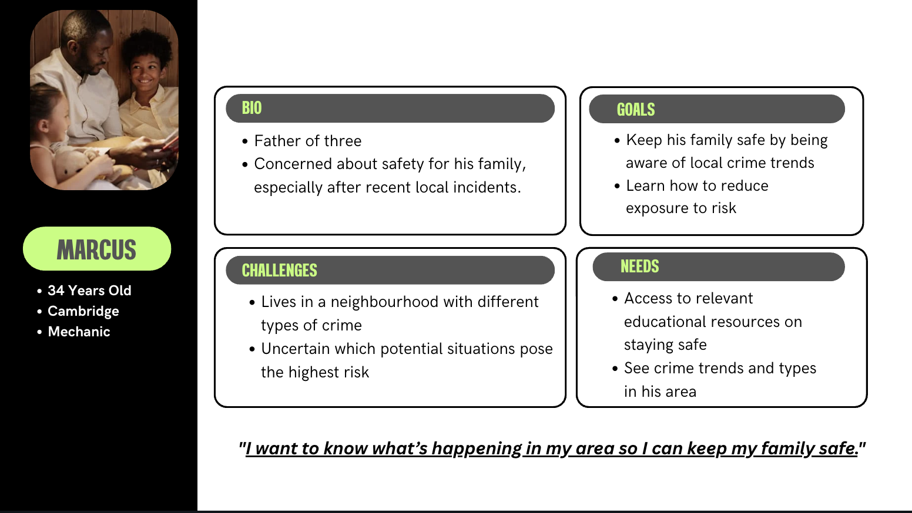

Slide 14
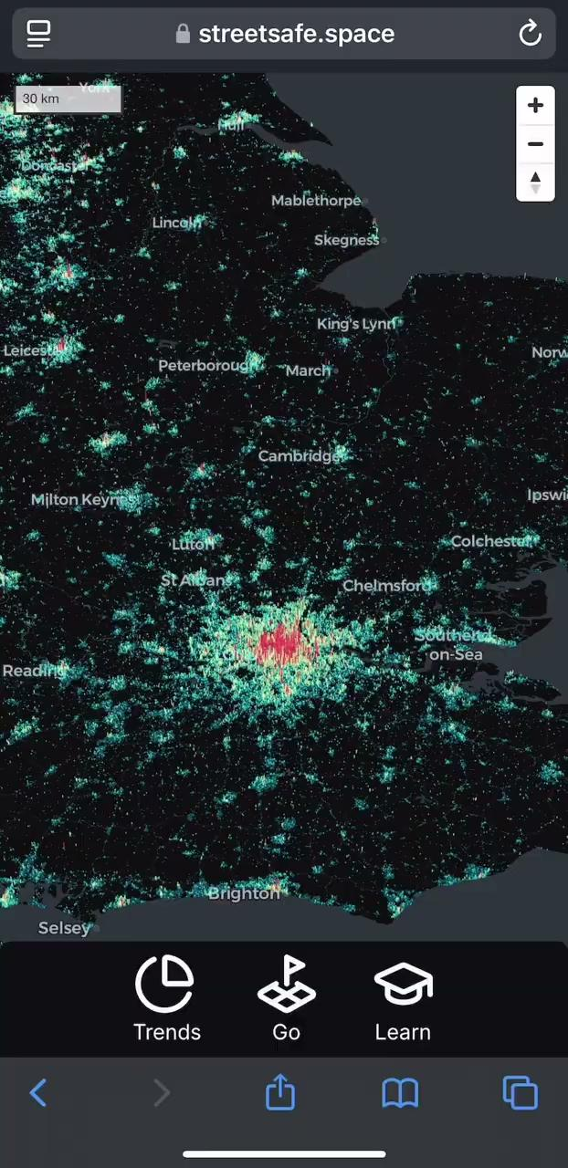
Learn/Trends Demo

Slide 15
Planning &
Delivery
03

Slide 16
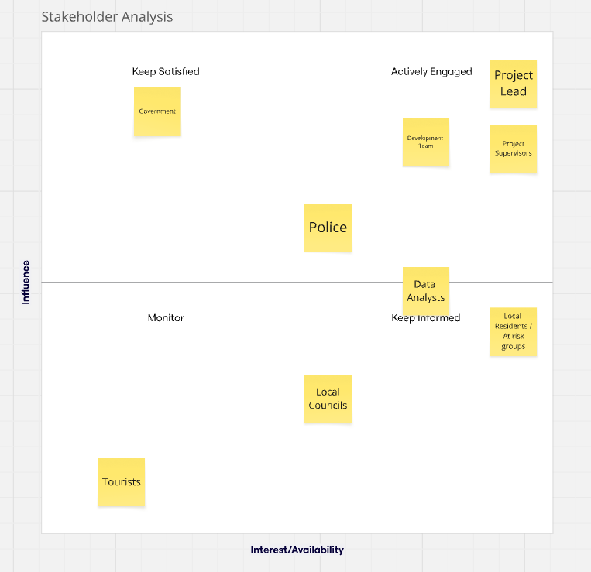
Stakeholder Analysis

Slide 17
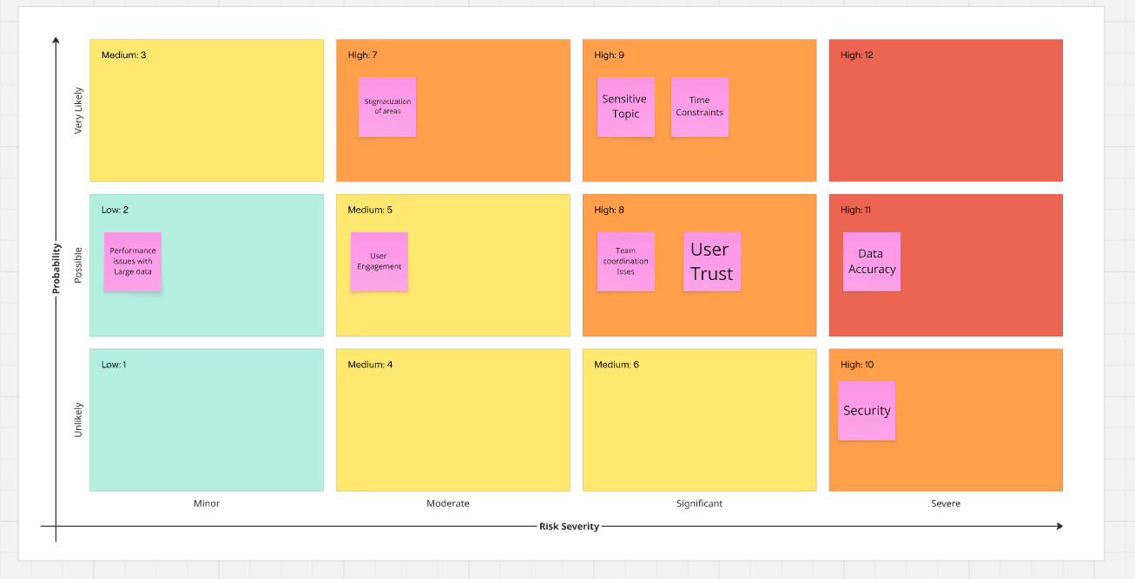
Risk Assessment
Notes:
Displays safe routes = needs Data Accuracy
Displays high crime areas = Stigma

Slide 18
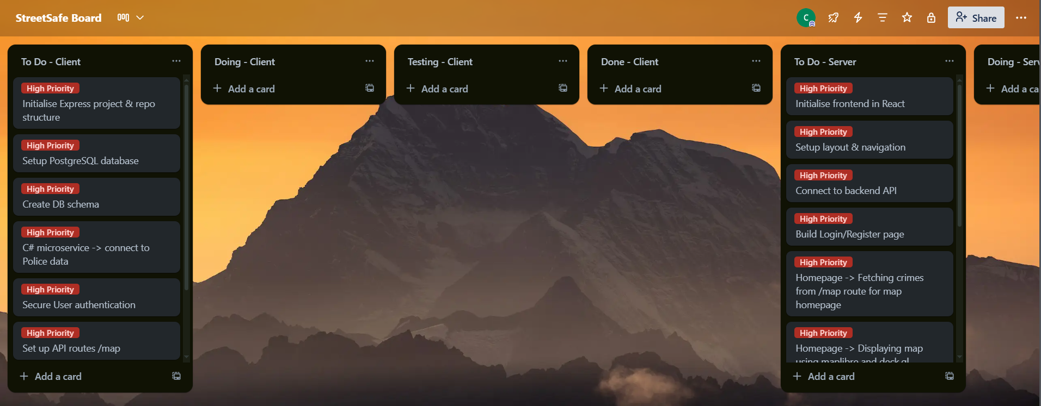
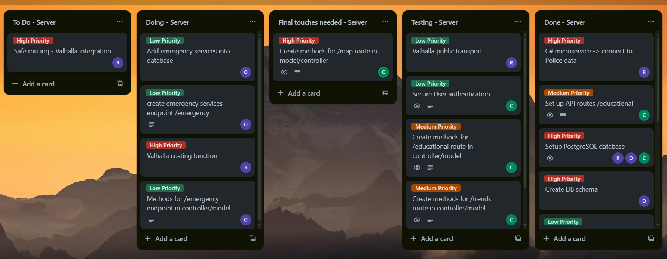
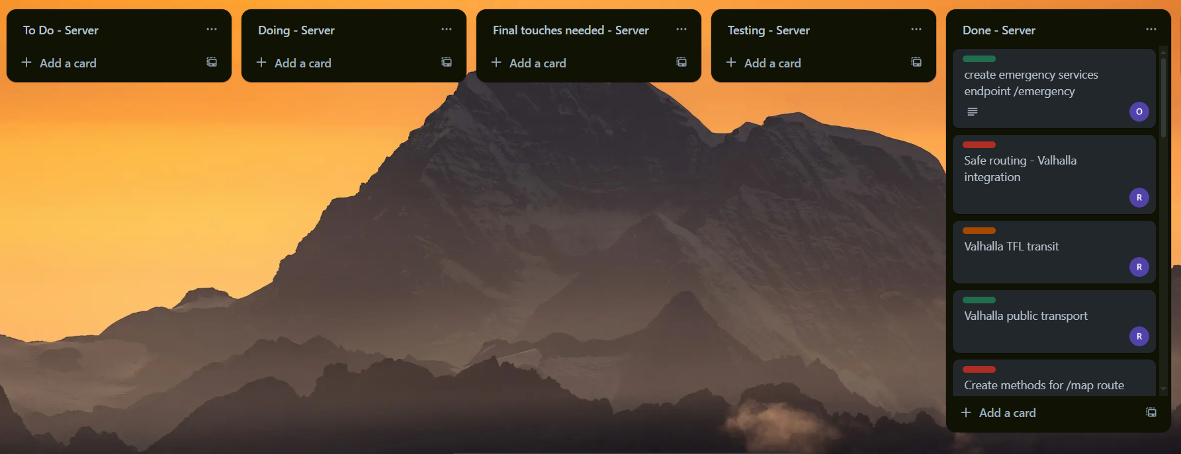
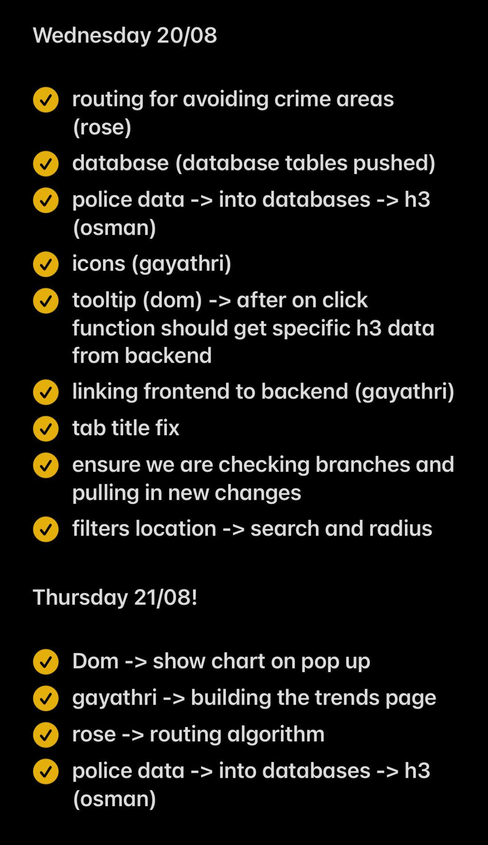
Trello Board/Standups
Broke key features into requirements and placed on trello board.
Ranked each requirement based on priority to complete an MVP.
Assigned team roles to each requirement so everyone knew of their task.
Standups every morning ensuring everyone knew of their tasks for the day.
Meetings in the evening going through what we did for the day, where we were stuck and what needed to be done tomorrow.

Slide 19
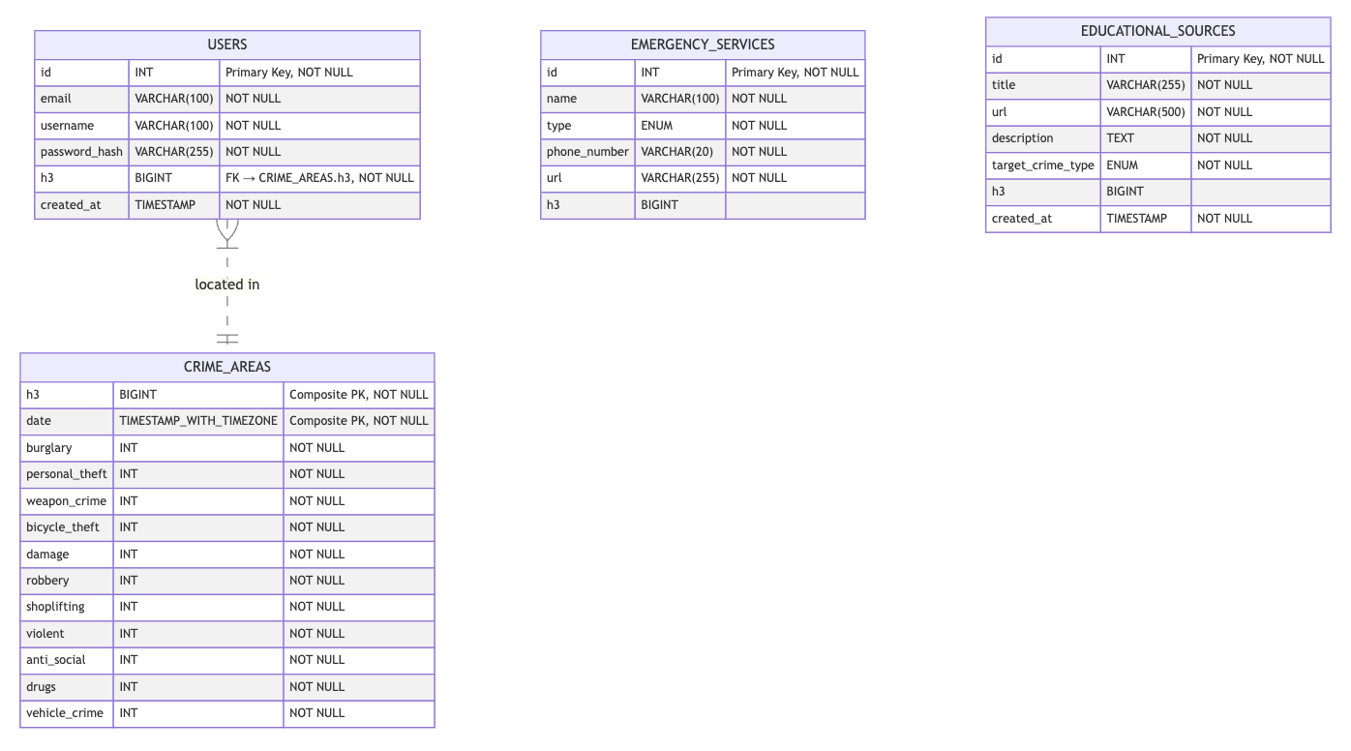
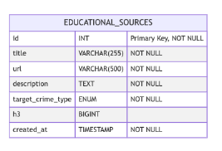
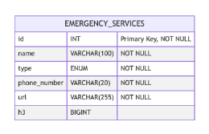
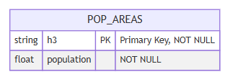
Entity Relationship Diagram
Notes:
Stored our data, location as h3

Slide 20
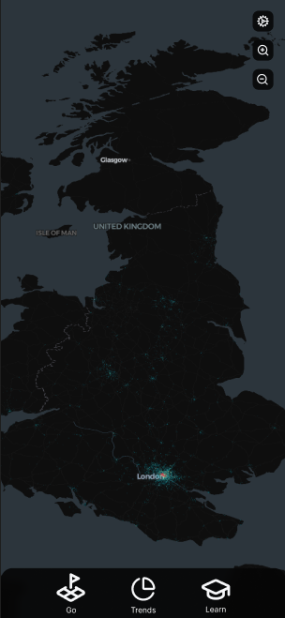
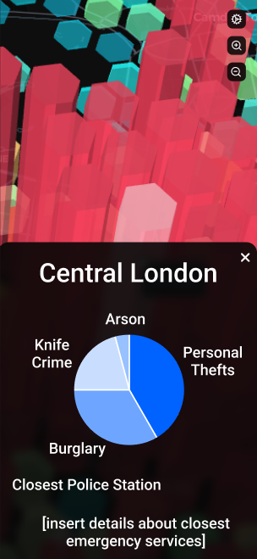
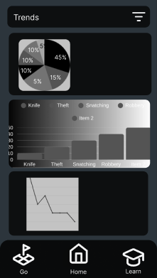
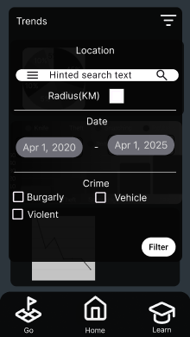
Wireframes
Subtitle

Slide 21
Technologies
& Languages
React Tailwind H3
Deck.gl Maplibre Express
Vite Postgres Docker
Valhalla Vitest Jest
NUnit 3 JS C#
CSS SQL C++

Slide 22
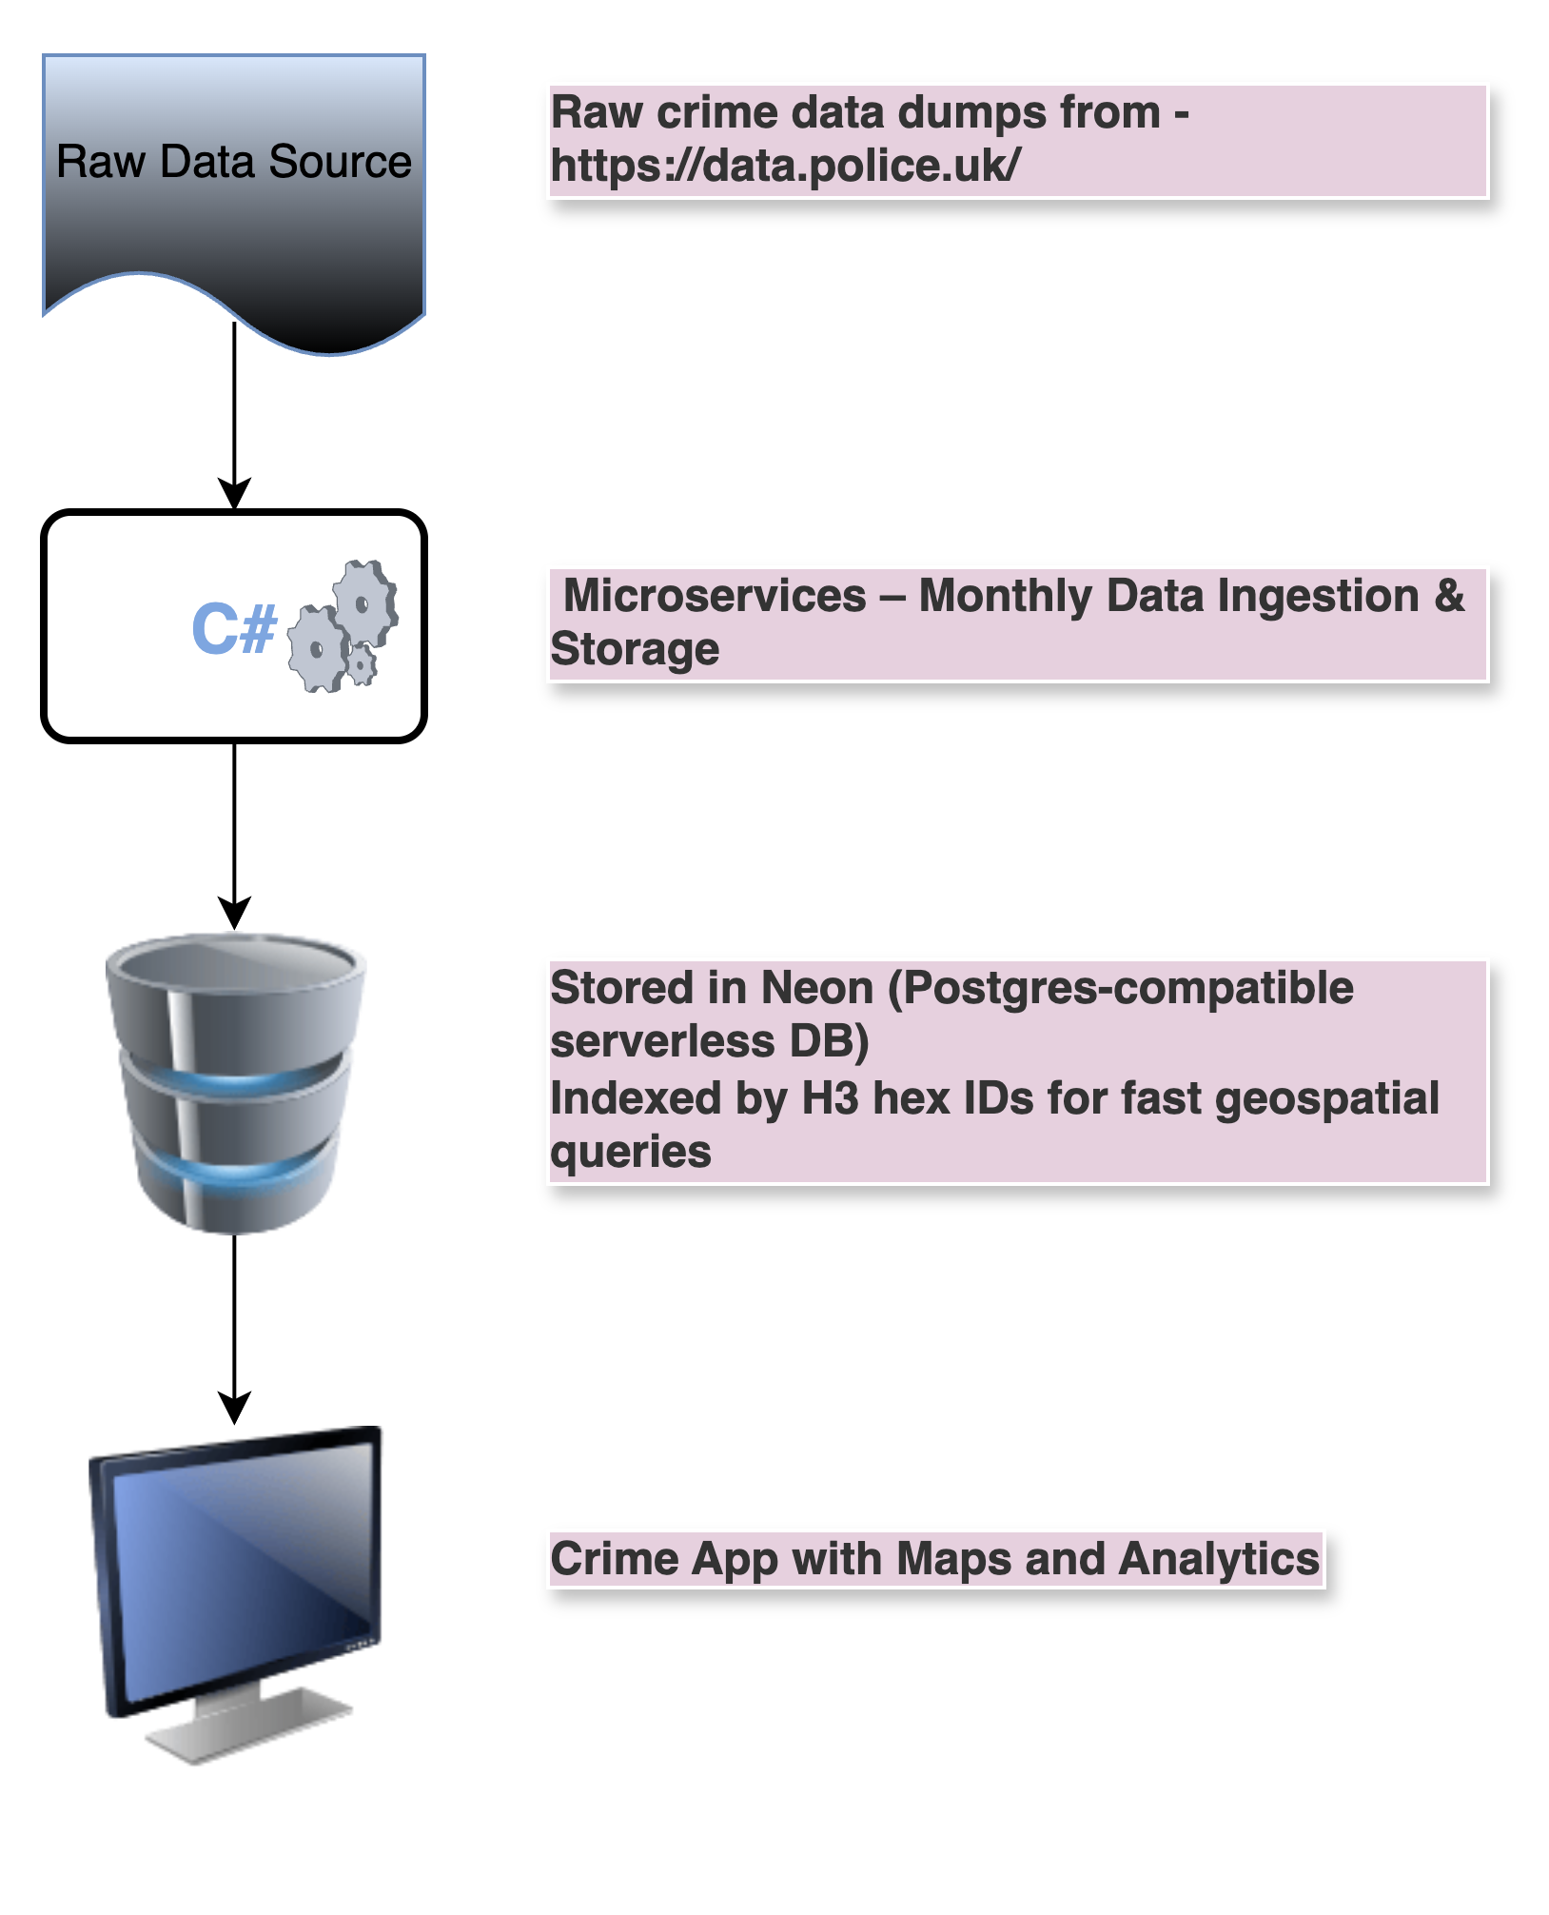
Data Flow
Notes:
C# microservice to ingest the data into our database for speed and performance.
Neon database (Postgres) as it allows for a H3 extension for faster queries
Methods in the backend will use raw SQLqueries to interact with the database.
The retrieved data will be passed to the frontend and displayed in map or graph format.

Slide 23
Testing
04

Slide 24
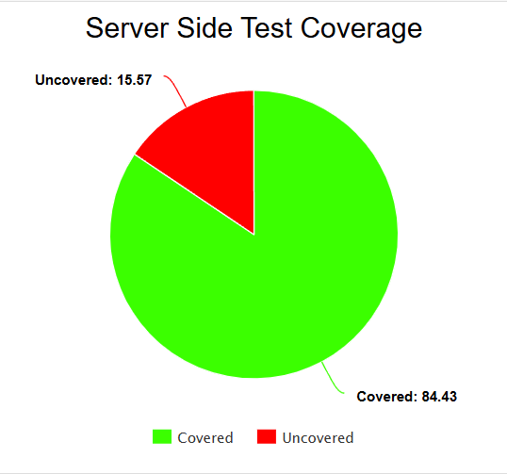
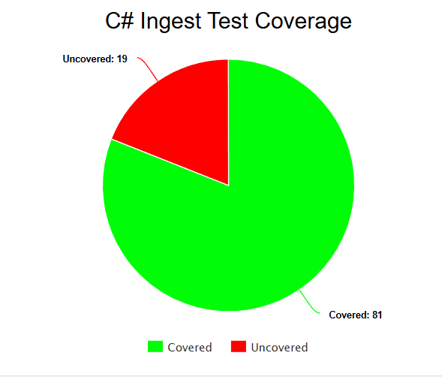
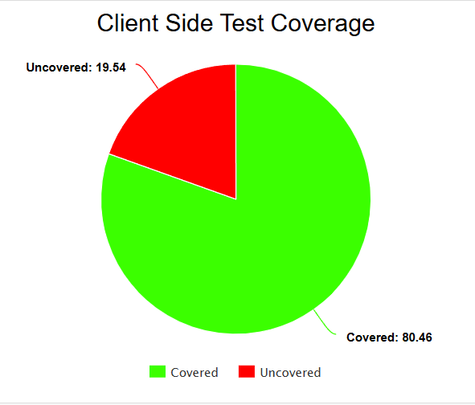
Testing Coverage

Slide 25
Project
Reflection
04

Slide 26
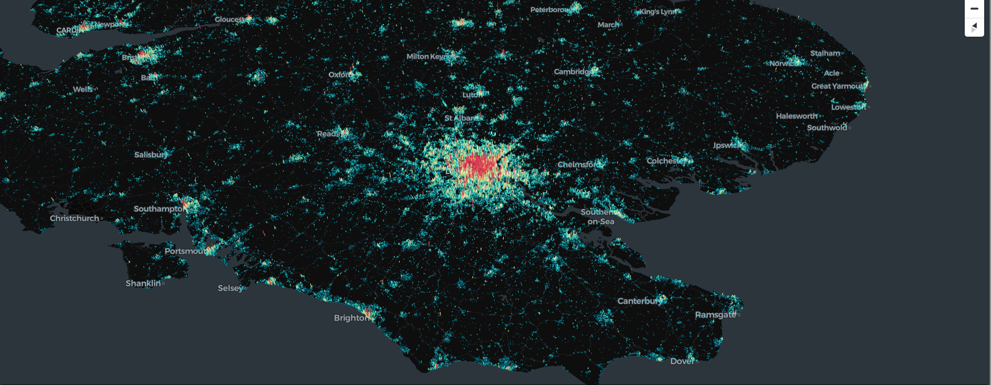
Significant Wins - Map (H3)
Uses Uber's H3 geospatial indexing system for location mapping
Essentially splits the world up into grid hexagons.
Allows us to store locations in 1 dimensional format to save space.
Can query more general areas efficiently.

Slide 27
Challenges & Solutions
Processing and storing large amounts of crime data slowed development.
SOLUTION: Used C# microservice to preprocess and import data efficiently and used caching to improve responsiveness.
2. Learning curve with ViTest slowed development as we needed to adapt to new technology.
SOLUTION: Rose provided training sessions and provided documentation to upskill the group.

Slide 28
Future Features
Real Time Crime Alerts
Map Layers (different types of crime, emergency locations)
Personalised Monthly Crime Report
Public Transport On Go Feature

Slide 29
Thank You

