Slide 1

VivaLingo
Bringing the BUZZ back to Hive Learning
Created by the Syntax Schoolers
We say OUI to learning!

Slide 2
Meet the Team
Osman
Katelyn
Salma
Dom
Project Manager

Slide 3
Our Solution
A gamified French learning app that transforms language education through:
Fun, interactive exercises
Progressive difficulty levels that build confidence
Focuses on simple, repeatable, memory-friendly activities
Dual-User Approach
Student dashboard for personalised learning journeys
Staff dashboard for content management
Result:
An application that addresses the Hive Foundation's challenge by re-engaging secondary school students with non-STEM subjects through technology they enjoy using.

Slide 4
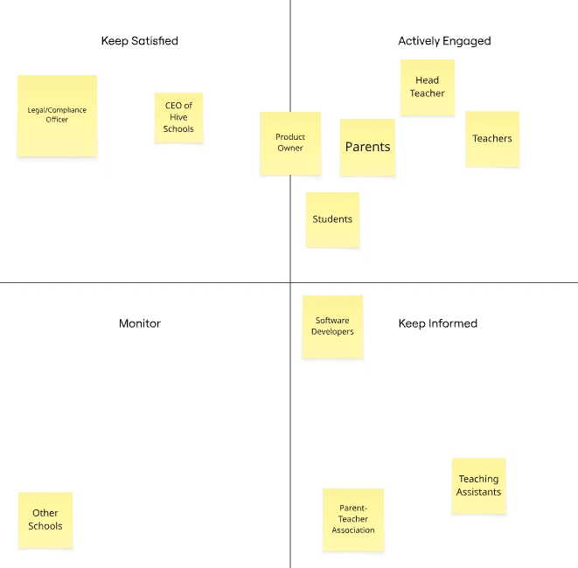
Stakeholder Analysis
Main Stakeholders:
Teachers
Students
Legal Compliance Officers
Influence
Interest/Availability

Slide 5
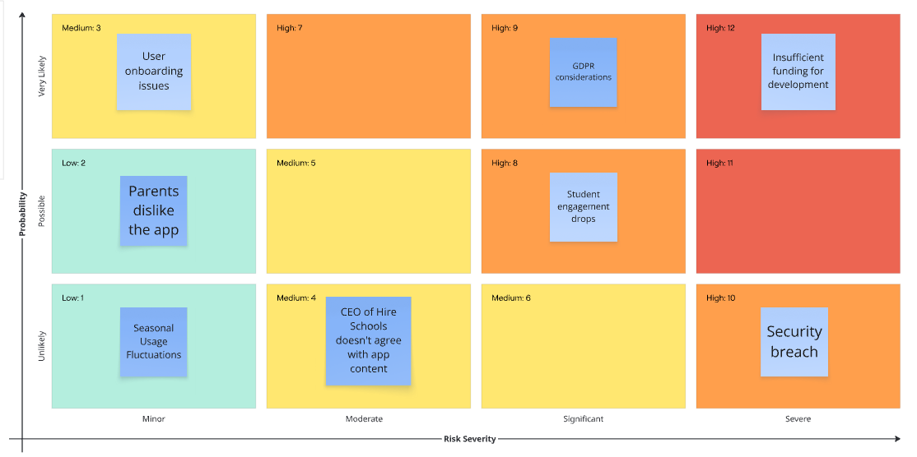
Risk Assessment Matrix

Slide 6
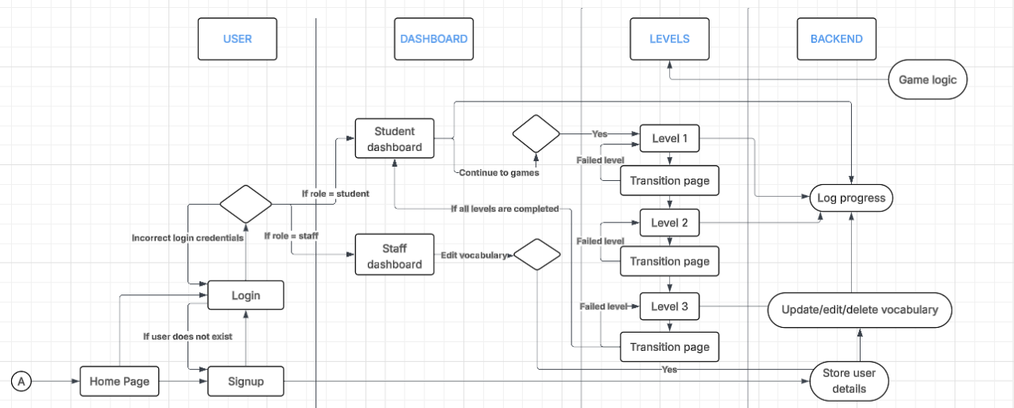
High Level Solutions Diagram

Slide 7
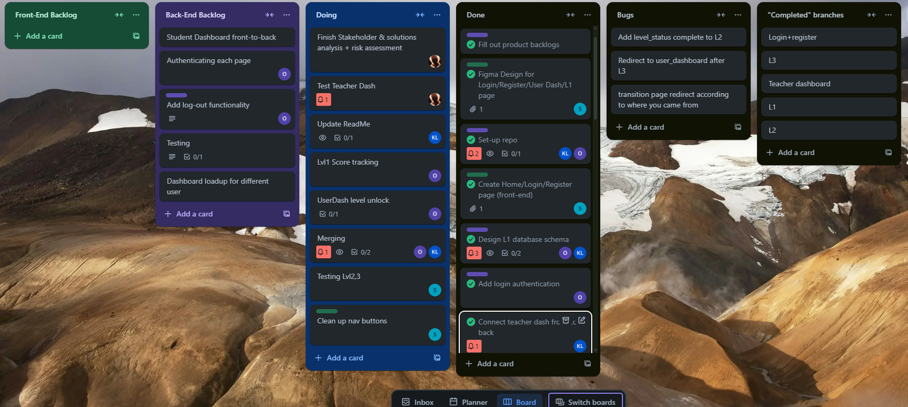
Trello Board
Notes:
https://trello.com/b/BmrQlTU3/user-stories

Slide 8
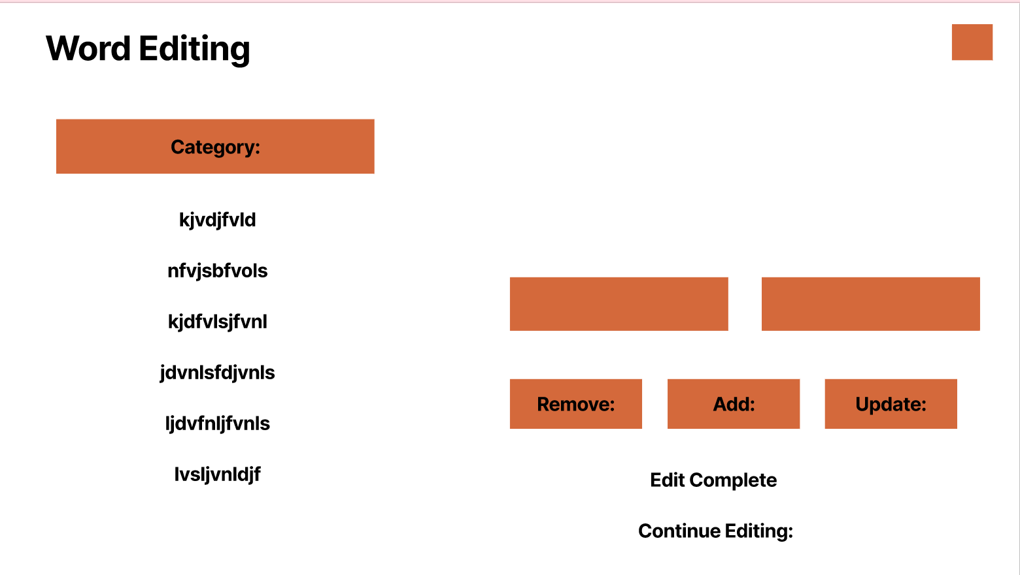
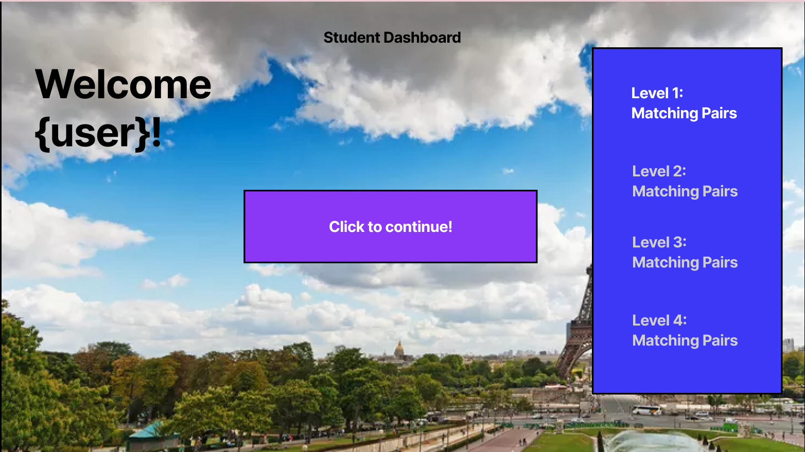
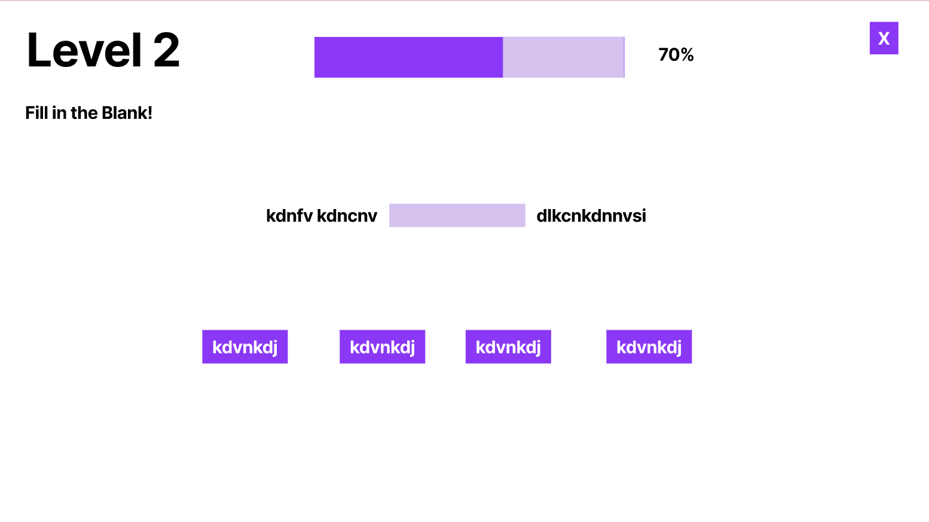
Wireframes
Initial Figma Design:
Playing with ideas!
Notes:
https://www.figma.com/slides/Vg27YAZeqVp2Rsq0ZYQohD/ViveLingo?node-id=1-42

Slide 9
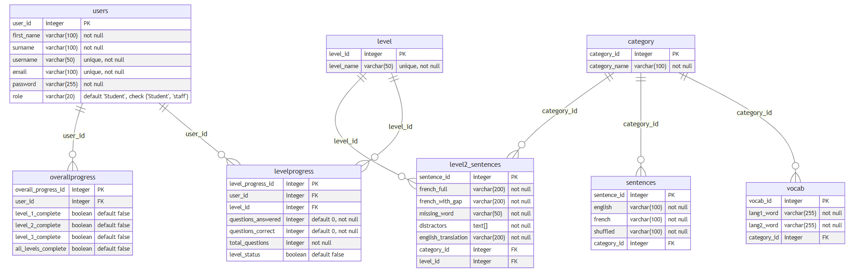
ERD

Slide 10
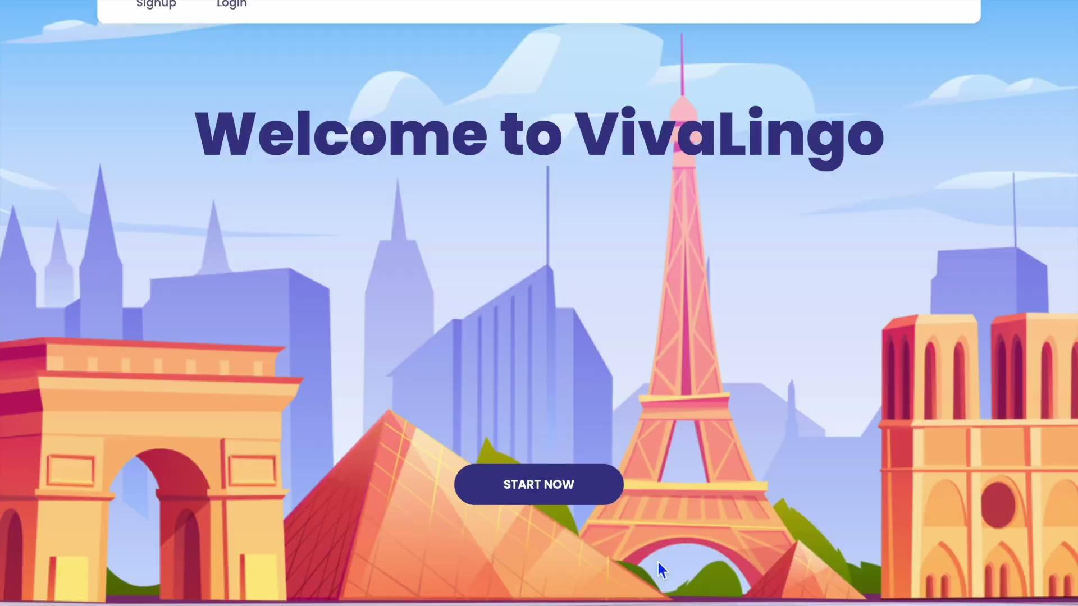
Demo

Slide 11
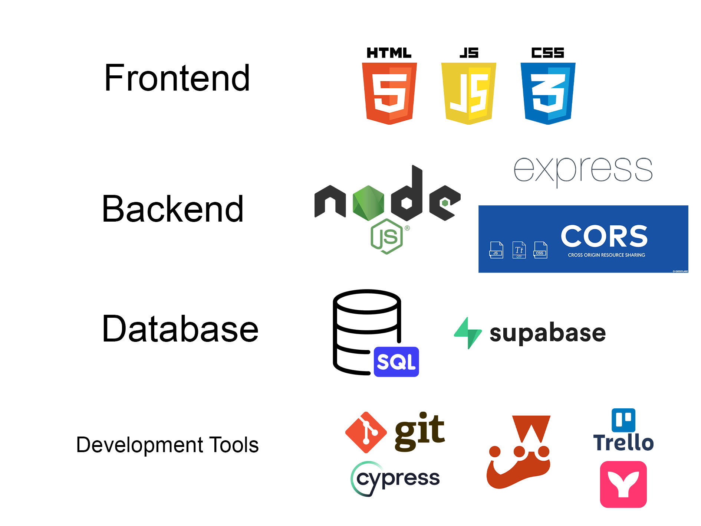
Technologies:
Frontend
hi
Database
hi
Backend
hi
Development Tools
Notes:
Frontend
HTML and CSS - For responsive design and styling
JavaScript - Interactive game mechanics and UI
Backend
Node.js - Server-side JavaScript runtime
Express.js - RESTful API framework
JWT - Secure user authentication
MVC Architecture - Scalable code organisation
Database
SQL - Relational data modeling
Supabase - Cloud database hosting and management
Development Tools
Git & GitHub - Version control and collaboration
Trello - Agile project management
Figma - Wireframes
Mermaid.js - Database ERD visualisation
Jest - unit testing
Cypress - End-to-end testing

Slide 12
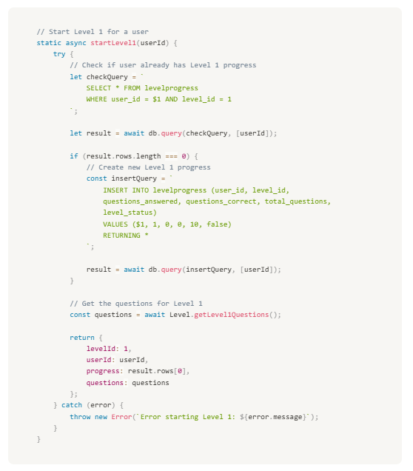
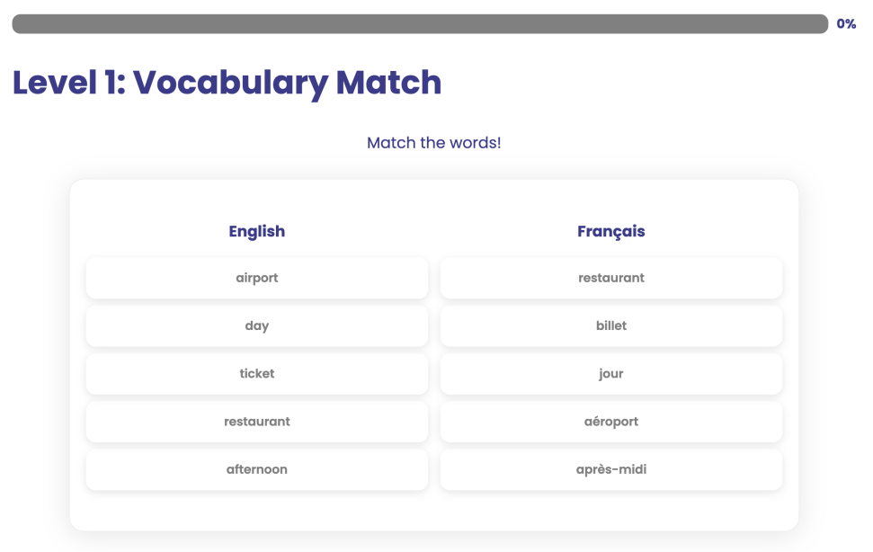
Significant Code
Level 1 Model Snippet:
Async function that begins level 1

Slide 13
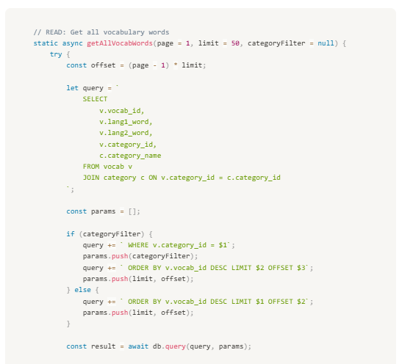
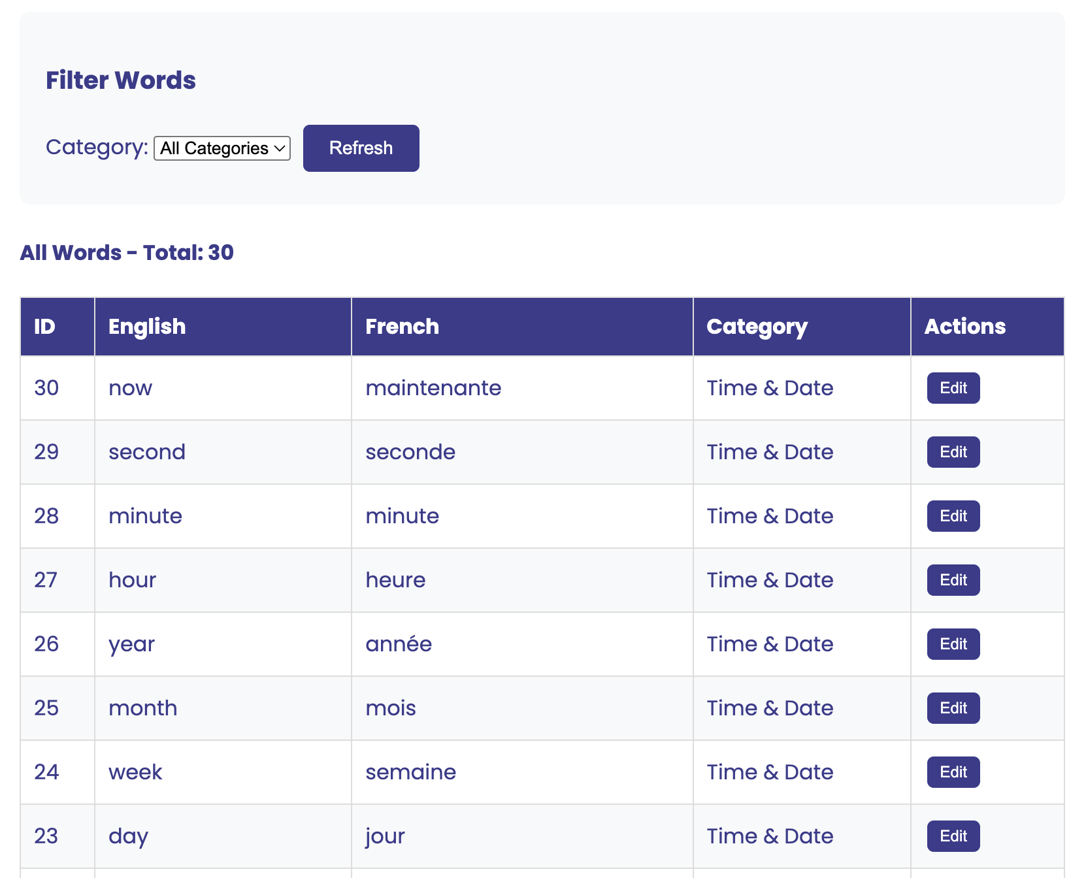
Significant Code
Teacher Dashboard Snippet:
Function that allows teachers to view all vocab

Slide 14
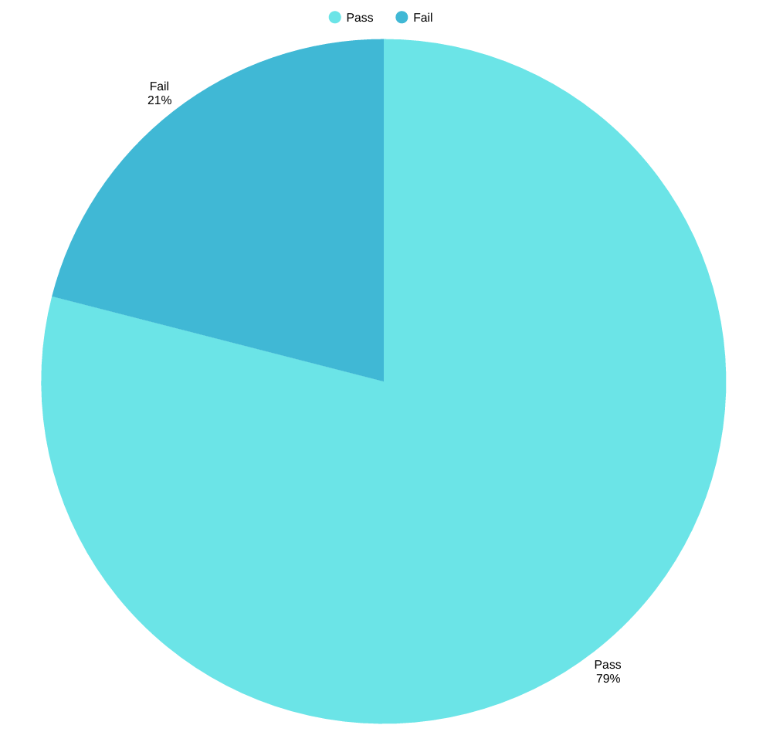
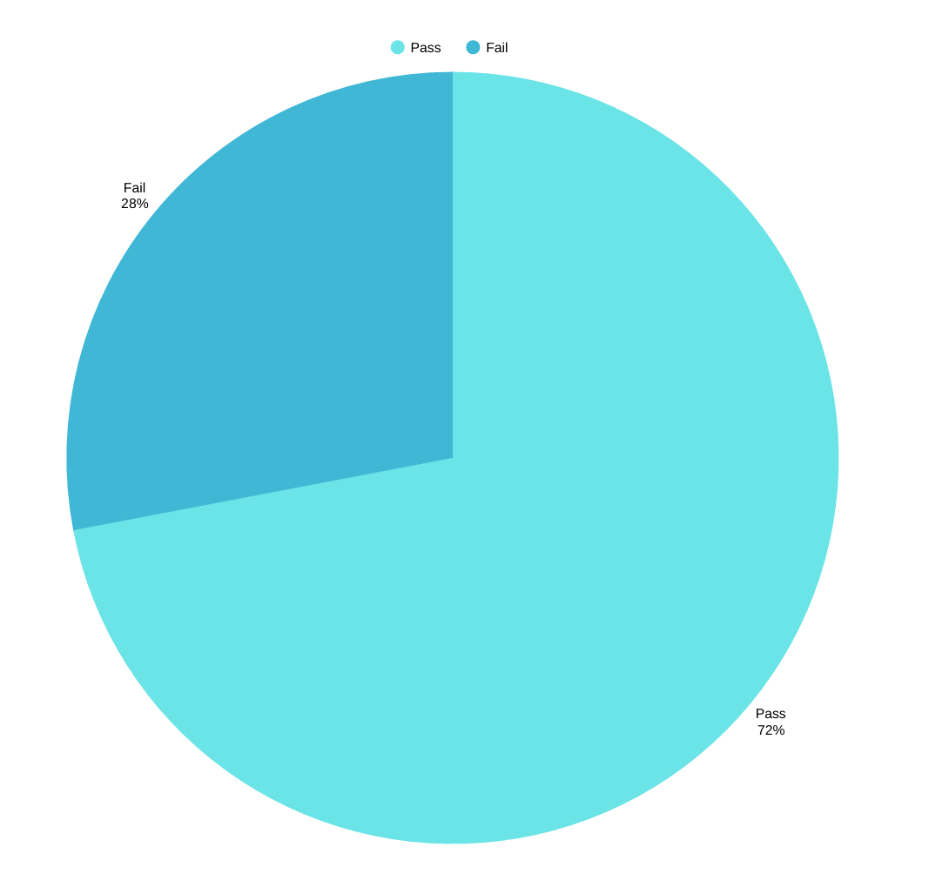
Test Coverage
Frontend Testing:
Backend Testing:

Slide 15
Challenges and Solutions
Branches in our initial repo
  Solution: feature specific named branches
Integrating backend and frontend seamlessly + merging
  Solution: dedicated merging session to ensure all conflicts were sorted early on
Setting realistic timeline for features
  Solution: dividing the day into thirds + Trello management (smaller tasks)

Slide 16
Future Features
Extra Gamified Features:
Timer feature
Leaderboards
  Class-wide competitions
Advanced Levels
  Future levels with complex grammar and tenses
Addition of other languages e.g., Spanish, German etc…

Slide 17
Reflection
Next time we will:
Begin testing process earlier
Limiting progress due to circular dependency
Create feature specific named branches for clarity
Overall a difficult project but rewarding!

Slide 18
Questions?

